Slide 1

AI training group
Weekly Report
Nguyen khai phu – OCT 20 2023

Slide 2
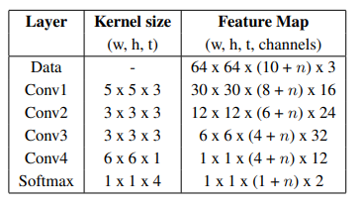
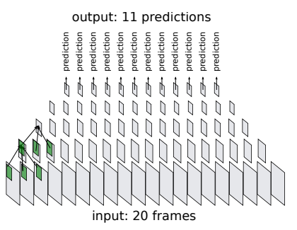
Model
ISP008 foundation
RFSBD
Shot Bound Detection
No linear layer
Apply softmax on the Conv layer to extract multiple predictions on each frame in one run
deepSBD
Addding linear layers for classification
Build and train from scratch
2
CISP-1352-A21 - ISP-DOC-STYLETYPE-Templates © Robert Bosch GmbH 2016. All rights reserved, also regarding any disposal, exploitation, reproduction, editing, distribution, as well as in the event of applications for industrial property rights.

Slide 3
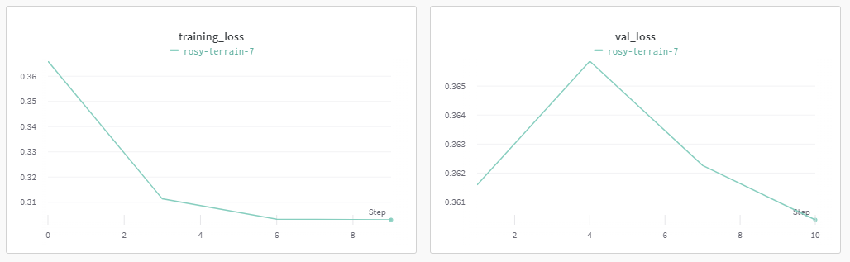
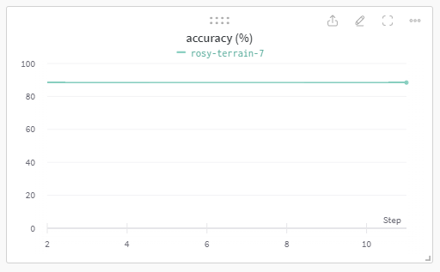
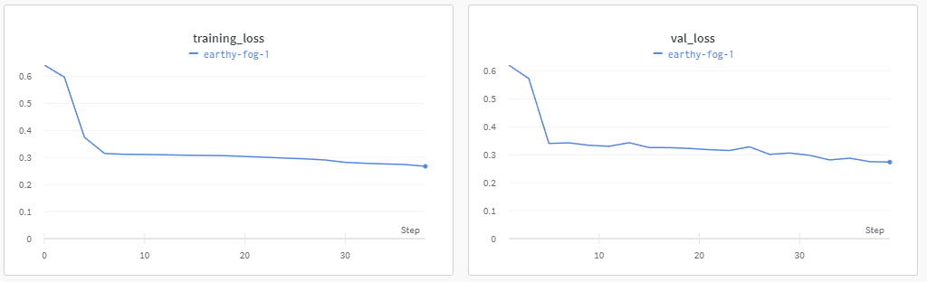
Training results
ISP008 foundation
2
CISP-1352-A21 - ISP-DOC-STYLETYPE-Templates © Robert Bosch GmbH 2016. All rights reserved, also regarding any disposal, exploitation, reproduction, editing, distribution, as well as in the event of applications for industrial property rights.

